Slide 2
Microsoft Power BI, Power Automate, and Power Apps: Connecting to data using the on-premises data gateway
Smita Nachan
Nanddeep Nachan

Slide 3


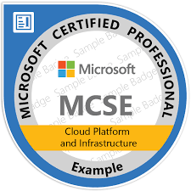





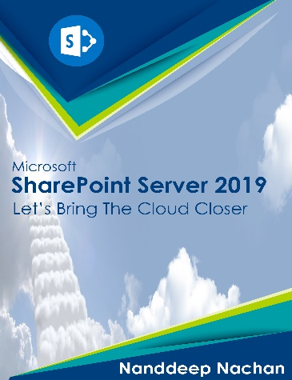



Nanddeep Nachan
Consultant - SharePoint, Office 365, MS Azure
Speaker | Author | Blogger
C# Corner MVP
Microsoft Certified Professional
NanddeepNachan@gmail.com
Certified Scrum Master (CSM)
Nanddeep.nachan
Certified Professional Photographer
@NanddeepNachan
/in/nanddeepnachan
nanddeepnachan
nanddeepn

Slide 4

Smita Nachan
Lead Software Engineer, Tieto
SharePoint, Office 365
Microsoft Certified Professional
Certified Scrum Master (CSM)
Smita.Nachan@gmail.com
/in/SmitaNachan
@SmitaNachan
Smita.nachan

Slide 5
Explore Hybrid terminology
Understand On-premises Data Gateway
Gateway architecture
Use the gateway in Power BI, Power Apps and Power Automate
Standardize Gateway Administration at a Tenant Level
Monitor gateway for performance

Slide 6
Hybrid

Slide 7
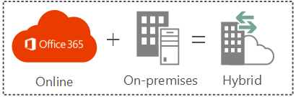
Hybrid Environment
Brings together best of both On-premises and Online (Cloud) features
Integrates functionality and access between features and services of both the environments.

Slide 8
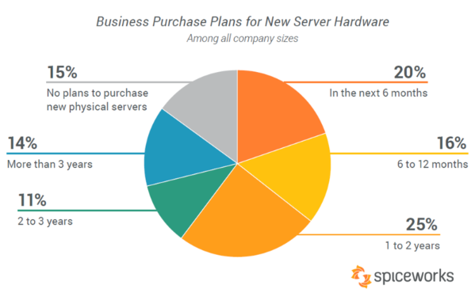
Industry Trends
Cloud-based infrastructure commands industry's attention,
But, 98% of companies run on-premise server hardware, according to more than 500 IT decision makers, in a Spiceworks survey released recently.

Slide 9
On-premises Data Gateway

Slide 10
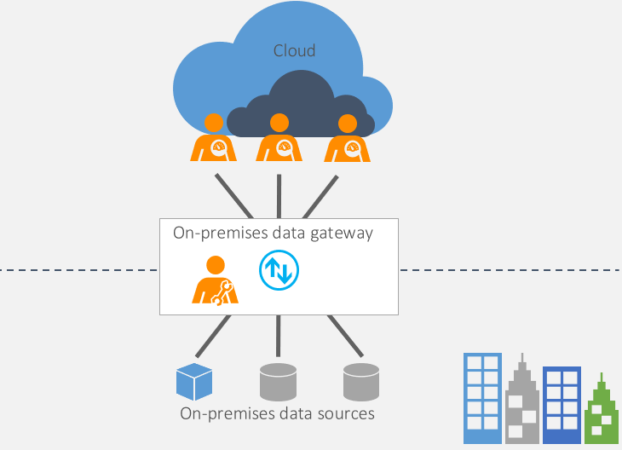
What is an On-premises Data Gateway?
One gateway for multiple cloud services and experiences
Power BI
Power BI dataflows
Power Apps
Power Automate
Power Platform dataflows
Azure Analysis Services
Logic Apps
Microsoft Search

Slide 11
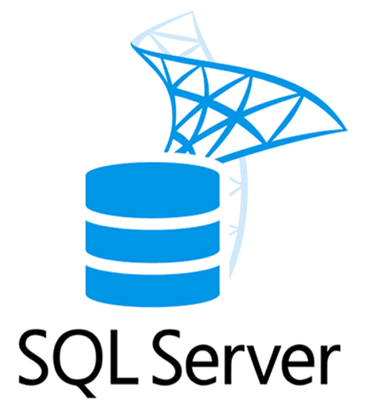

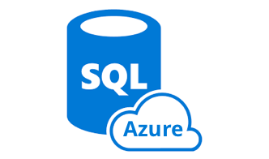


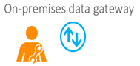

Do we need Data Gateway every time?

Slide 12
Personal mode vs. Standard mode
 | On-premises Data Gateway (Personal Mode) | On-premises Data Gateway (Standard Mode)
Target Persona/ Scenario | Business analysts | Enterprises requiring central data source management and access control
Use Case | Sets up and uses gateway for personal data sources only | Admins setup for employees within a department/ company
Features | Import with scheduled refresh | Direct query (for all services) and scheduled refresh (only for Power BI)
 | No additional data source configuration to setup a refresh | Gateway admin needs to configure each data source explicitly
 | Data source connections managed per user | Central data source management and access control
Services supported | Power BI | Power BI, Power Apps, Power Automate, Azure Logic Apps, Azure Analysis Services, Power Query Online with CDS

Slide 13
Data Gateway
Installation
Download and install from http://go.microsoft.com/fwlink/?LinkID=820931

Slide 14
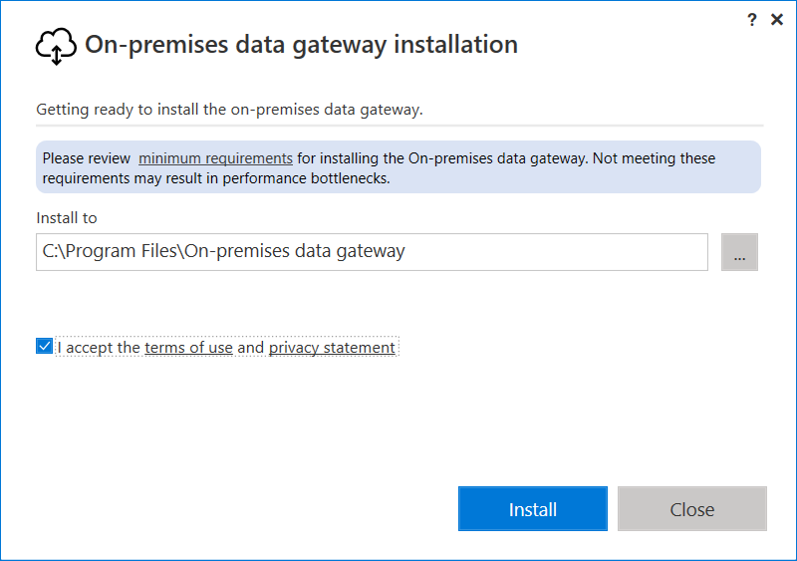
On-premises Data Gateway installation…

Slide 15
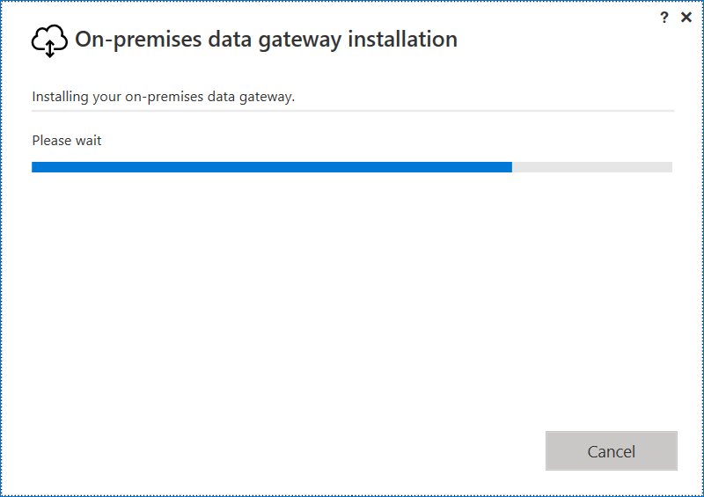
On-premises Data Gateway installation…

Slide 16
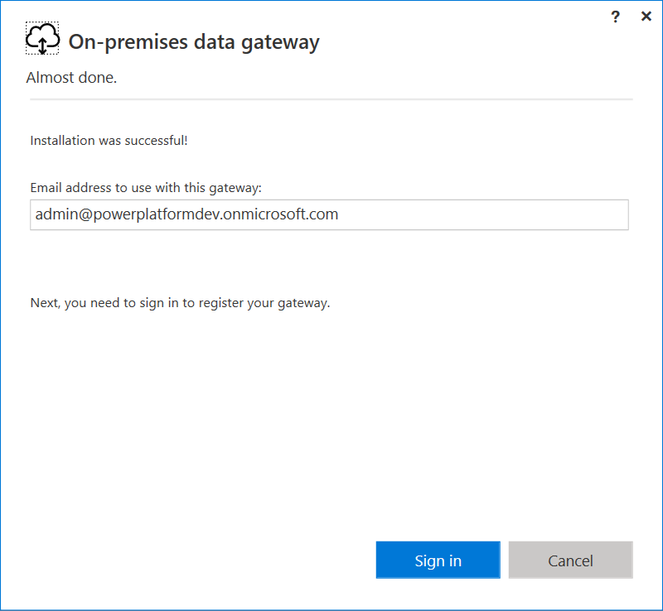
On-premises Data Gateway installation…

Slide 17
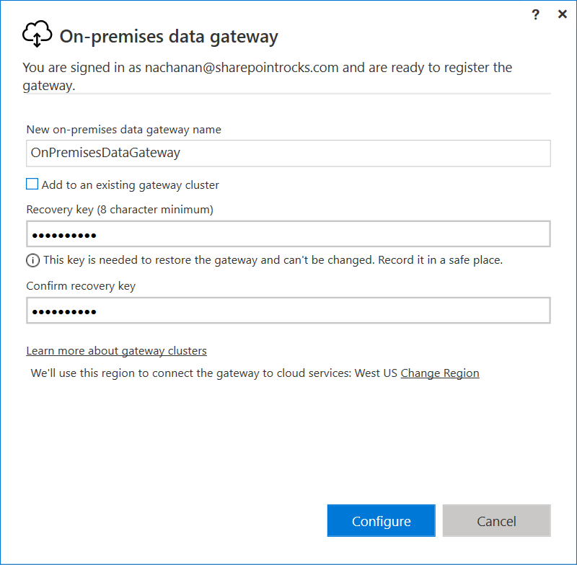
On-premises Data Gateway installation…

Slide 18
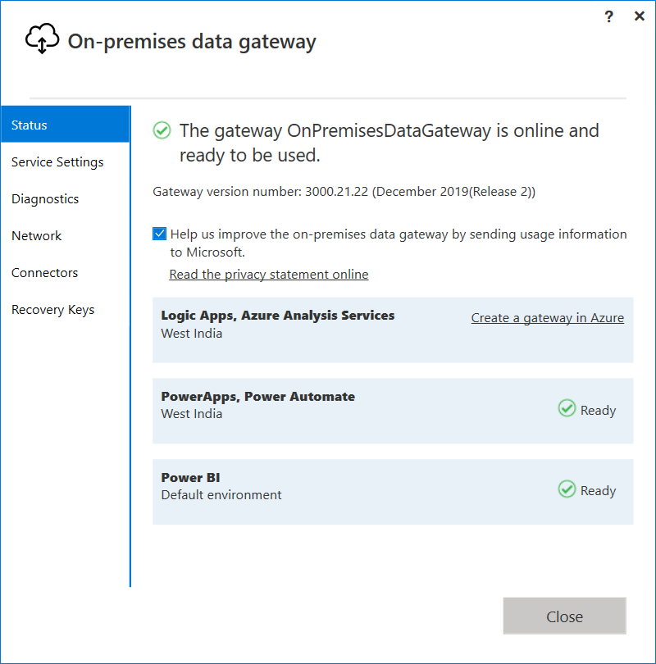
On-premises Data Gateway installation…

Slide 19
Data Gateway
Configuration

Slide 20



Gateway - few considerations
Install on a domain-joined machine. Do NOT install gateway on a domain controller.
The gateway should be always up and running. Therefore it should not be installed on a machine that may turn off.
The machine hosting gateway should always be connected to the internet.
Gateway performance might not be good over a wireless network.
Outbound traffic only.
Automatically provisions Azure Service Bus Relays.

Slide 21
On-premises Data Gateway Architecture
Cloud services
Power BI/Dataflows
Azure Analysis Services
Power Apps
Power Automate
Azure Logic Apps
Power Platform Dataflows
Gateway Management Cloud Service
Azure Service Bus
On-premises Data Gateway
Data source connection credentials can only be decrypted by the gateway
On-premises data sources
SQL Server Analysis Services
Other data sources
SQL Server
Files, SharePoint

Slide 22



Configuring Gateway Clusters for HA
Power BI
Cloud
On-premises
Gateway Cluster
SQL DB/DW

Slide 23
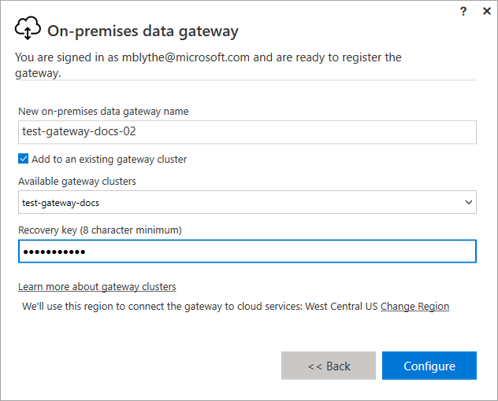
High Availability and Load Balancing
High Availability
Adding New members to a gateway cluster
During install create a new cluster or join existing cluster
Recovery key is required
Must be admin of original gateway
Load Balancing
A gateway cluster automatically distributes traffic across all gateways in that cluster
Version discrepancies amongst members can cause unexpected refresh issues
*Note: PowerShell commands are available for HA operations
https://aka.ms/GatewayPowerShell

Slide 24
Use the gateway in Power BI

Slide 25

Power BI
Turns unrelated sources of data into interactive insights
Connect to various data sources
Create interactive reports
Power BI consist of a
Windows desktop application (Power BI desktop)
An online SAAS service (Power BI service)
https://powerbi.microsoft.com

Slide 26
Power BI Direct Query On-premises
Gateway is installed & configured. During configuration, a dedicated Service Bus channel is automatically configured.
Credentials entered for the data source in the cloud services are encrypted, tested, then stored encrypted. Only the associated gateway (cluster) can decrypt the credentials. The Power BI Personal Gateway keeps credentials on-prem only.
One of the supported cloud services kicks off a refresh or a live query.
Data Movement Service analyzes the query and pushes to appropriate Service Bus communication channel.
Gateway polls its Service Bus channel for pending requests. It takes the pending request.
Gateway fetches the query, decrypts the credentials, sends query to the data source for execution.
Upon query execution, the gateway securely streams the data compressed to the cloud service.
Cloud Service
cred
2
Scheduler Service
3
Data Movement Service
4
Cloud
Azure Service Bus Channel
On-premises
7
5
Gateway
1
cred
2
6
DB

Slide 27
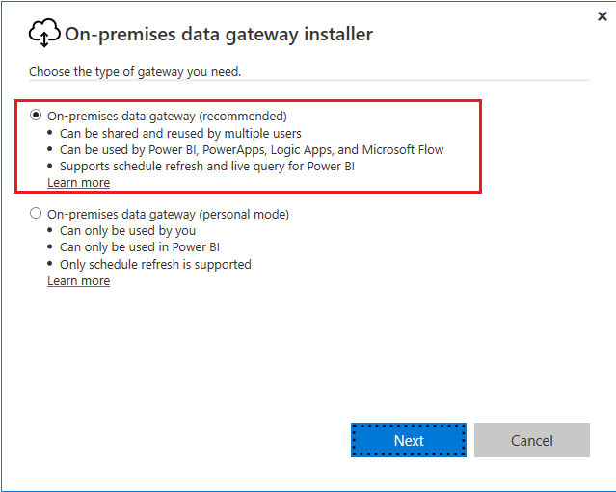
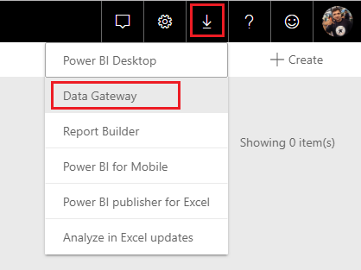
Power BI – Install Data Gateway

Slide 28
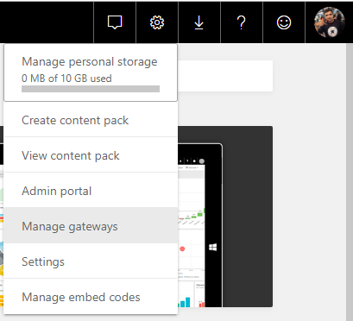
Power BI – Manage Data Gateway

Slide 29
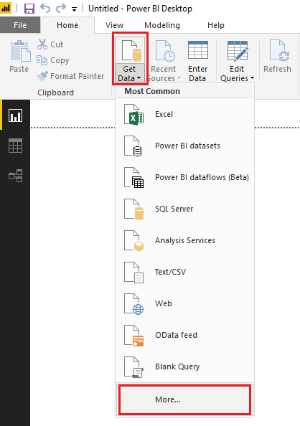
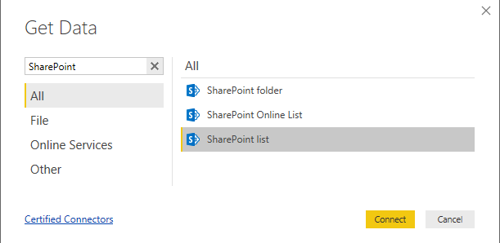
Power BI – Create Data Source
https://powerbi.microsoft.com/en-us/desktop/

Slide 30
Create Data Source
Power BI Desktop (https://powerbi.microsoft.com/en-us/desktop/)

Slide 31
Power BI Reporting

Slide 32
Use the gateway in Power Apps

Slide 33

Power Apps
Build custom apps with No code / Low code
Responsive design
2 Types
Canvas apps
Model-driven apps
https://web.powerapps.com

Slide 34
Power Apps
https://web.powerapps.com

Slide 35
Use the gateway in Power Automate

Slide 36
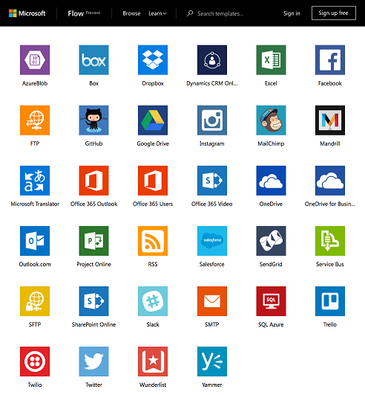
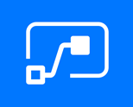
Power Automate (earlier MS Flow)
Cloud-based software
Allows to create and automate workflows and tasks across multiple applications
https://flow.microsoft.com

Slide 37
Power Automate
https://flow.microsoft.com

Slide 38
Standardize Gateway Administration at a Tenant Level

Slide 39
Gateway Management with Admin Center
a unified portal for administrators to manage environments and settings for Power Apps, Power Automate, and model-driven apps in Dynamics 365
https://admin.powerplatform.microsoft.com

Slide 40
Gateway Management PowerShell
New PowerShell Cmdlets
Examples:
Return all gateways within your tenant.
Get-DataGatewayCluster -Scope Organization
Return list of gateways, you are administrator of.
Get-DataGatewayCluster -Scope Individual
Restrict installation of on-premises data gateway
Set-DataGatewayTenantPolicy -ResourceGatewayInstallPolicy Restricted
https://aka.ms/GatewayPowerShell

Slide 41
Gateway Usage and Performance Monitoring

Slide 42
Gateway Usage and Performance Monitoring
Which data source is slowing down my gateway?
What is going-on on my gateway?
Is my gateway used mostly for PBI DirectQuery or refreshes?
How do these queries impact system performance?
Why is my gateway slow?
Should I tune this query?
Which data sources have the highest failure rates?
Should I start using load balancing for better performance?
When is my gateway the busiest?
Are there frequent query failures?
Performance monitoring in public preview (Docs)
Configuration enabling Query execution and System Counters log files
Out-of-the-box Power BI template for visualization
Notes:
https://asankap.wordpress.com/2019/09/02/how-to-monitor-power-bi-gateway-using-a-power-bi-report/

Slide 43

Time to grab a Goodies

Slide 44
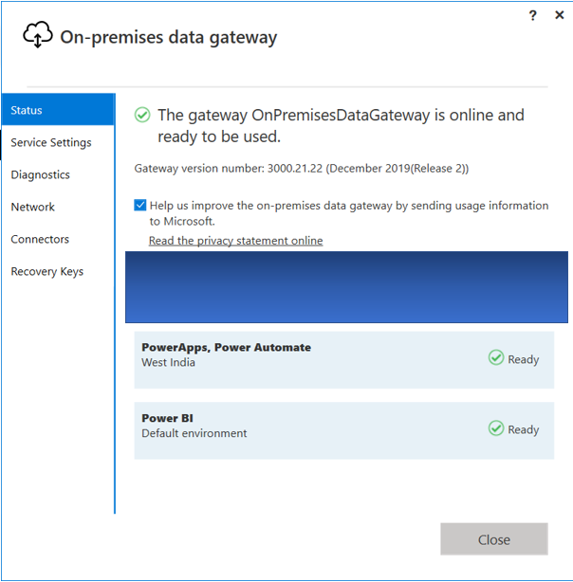
On-premises data gateway works with which of the Azure resources?
Answer:
Logic Apps
Azure Analysis Services

Slide 45


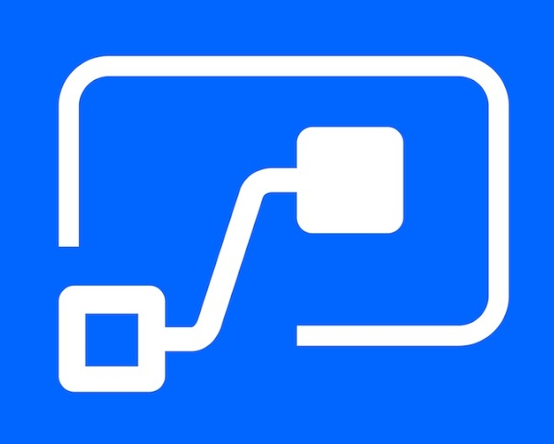
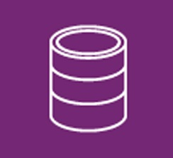


Identify Power Platform logos!
1
2
3
Power Apps
Power BI
Power Automate
4
5
6
Common Data Service / Model
Power Virtual Agents
AI Builder

Slide 46
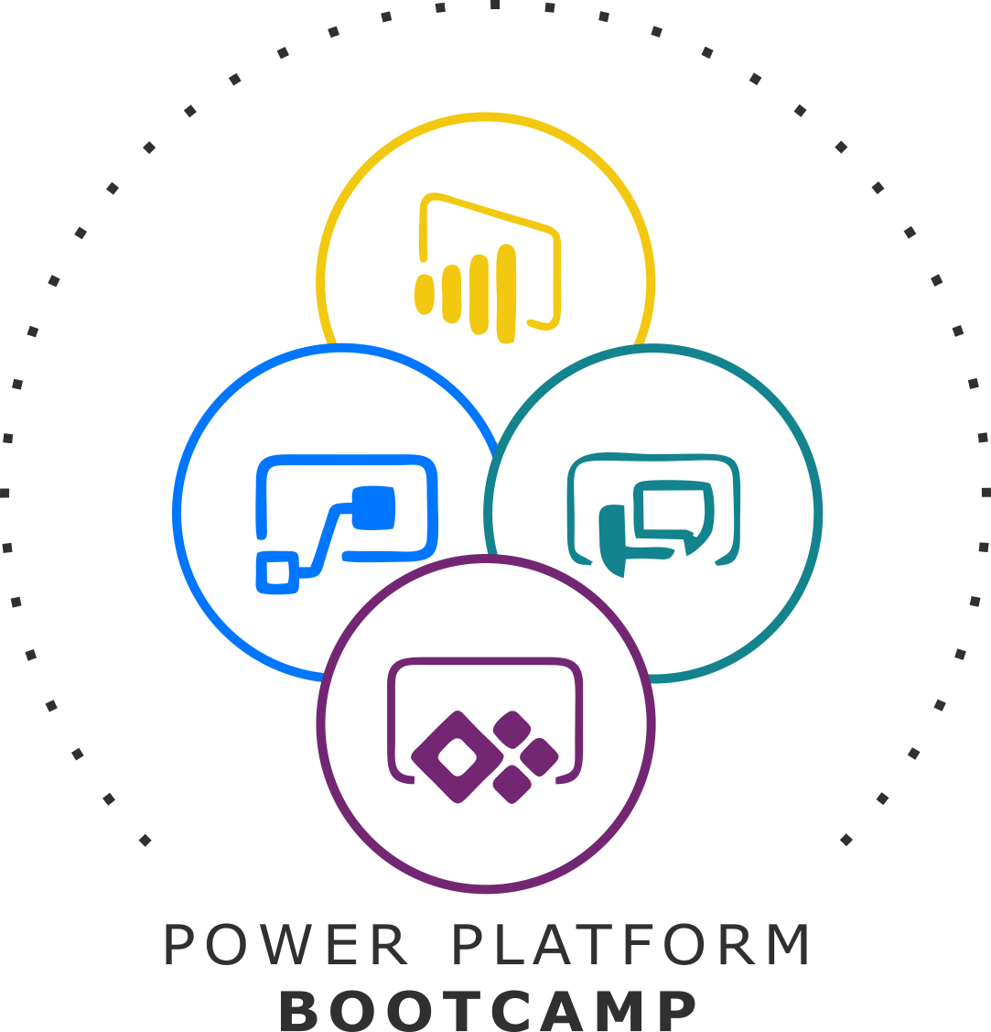
Enjoy the Bootcamp

Slide 47
Call to action
Start a Power Platform learning path at https://docs.microsoft.com/en-us/learn/powerplatform/
Join Office 365 developer program https://dev.office.com/devprogram to leverage all resources for Office 365 development learning
Build applications on Power platform
Attend local community events to continue learning on Power Platform development

Slide 49
Power of AI in Power Platform
Keval Solanki & Prasham Sabadra

